Slide 1
inTouch: Social inclusion and dementia care technology work
Dr Hazel Boyd
Bath Institute of Medical Engineering
KTequal - Dementia: innovative approaches towards a
better quality of life
27th January 2011, Sheffield

Slide 2
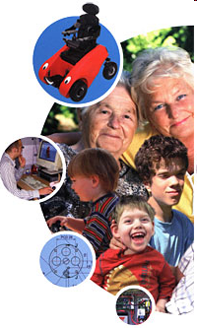
BIME – who and what
Medical engineering charity
Mixed staff
Technology for people with dementia User-led work

Slide 3
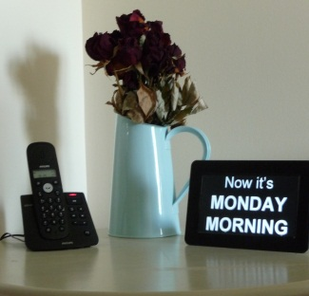
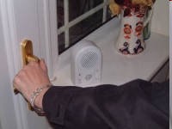
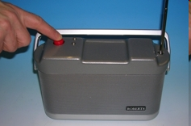
Dementia projects
Smart house technology
Smart village work
Prompting
Sequencing
Wander reminders
One-button radios
Simple music player
Day display
Not just about safety any more – Improve quality of life!

Slide 4

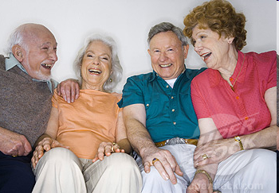
Social isolation
People with dementia can become isolated
  Many people with dementia live alone or in care homes
  Ability to communicate fades but the value of communicating does not
Even brief conversations can be stimulating
“People watching” is enjoyable!
Superstock.com

Slide 5
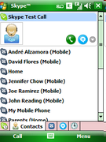
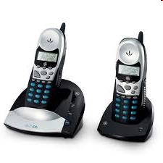
Video links – why?
Social isolation:
Is technology the problem or the solution?
What if we could link people together easily, so they could “visit” each other remotely?

Slide 6
inTouch…
…a video link system to reduce social isolation
for people with dementia
Simulate a visit, not a conversation – Immersive
For independent use with no training - Intuitive

Slide 7
inTouch – the set-up
Funding
Digital Economy
Collaborators and project partner
BIME – technical design and interface work
RICE – focus groups and clinical input
University of Bath – Video conferencing and TAM
Peggy Dodd Centre – User testing

Slide 8
Project stages
Focus groups – user preferences
Technology and platforms – making it happen
Interface design (user-led) – user capabilities
Spec development (what, how and why)
Testing to a home from Peggy Dodd Centre
Testing in homes

Slide 9
Pilot work - scope
How to start a visit independently
The video link itself
How to end a visit

Slide 10
Pilot work – what we tried
Peggy Dodd Centre in Bath – clients and staff
Connected two rooms together with a simple video link
The client was accompanied by the nurse manager
Used mock-up screens – no technology built yet!
Member of staff
Client

Slide 11


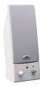

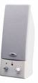




The cables!
WALL
Webcam
Webcam
Laptop screen
Laptop screen
Speaker
Speaker
Microphone
Microphone

Slide 12

Looks more like this…
“Hello, it’s Lynn here.
If you touch my photograph you’ll be able to talk to me”

Slide 13
Findings 1 – starting the link
The aim:
Encourage touching of the screen, to start the link
What didn’t work:
Still images (doorbells, buttons)
Text
What did work:
Recorded message of a familiar voice
Flashing border around a stationery photo

Slide 14
Findings 2 – starting the link
People respond to familiar(?) voices
Photographs (of whom?) are powerful
Subtlety of language is important (“Press” vs “Touch”)
Type of information was “if you…then…” - a choice
Repetition is useful (the “sinking in” effect)

Slide 15
Findings 3 – the video link
Awareness of seeing and being seen
  Staff are naturally good at reinforcing this, commenting on appearance
“You’re looking pretty in pink today”
“Pink to make the boys wink!”
“Right then, I’m going to go my love”
“Bye” [waves]

Slide 16
Pilot work - findings
“I might pinch it and take it home!”
Thoughts about the video link
I was quite intrigued with it, to tell you the truth… it was so advanced it was difficult to take it in!
“If I lost my jacket my wife could help me look for it”
“The telephone is nice, but to be able to see who you’re talking to…”
“Well I’m absolutely amazed…I would not have expected that… I’m absolutely gobsmacked!”

Slide 17
Conclusion and future
Video links have very strong potential to enable people with dementia to interact with people during “visits”
Even brief testing with a small number of people has given a lot of detailed insight
The inTouch project will look at the “big picture” of usability and usefulness of such a system
Focus groups
Technology and platforms
Interface design (user-led)
Spec development (what, how and why)
Testing to a home from Peggy Dodd Centre
Testing in homes

Slide 18
Acknowledgements
Pat Lysaght (Nurse Manager) and the staff and clients at the Peggy Dodd Centre in Bath for their ongoing support
Prof Roger Orpwood and Dr Bruce Carey Smith at BIME

Slide 19
Thank you
hazel@bime.org.uk
01225 824103
www.bath.ac.uk/bime

